Slide 1
FH Kufstein Tirol University of Applied Sciences
Does ESG Reporting Relate to Corporate Financial Performance in the Context of the Energy Sector Transformation?
By: Swagat

Slide 2
Declaration
I, Swagat Pruseth, hereby declare that the following presentation includes material and insights derived from the work of the esteemed authors Michał Baran, Aneta Kuźniarska, Zbigniew J. Makieła, Anna Sławik, and Magdalena M. Stuss. Their research has significantly contributed to the depth and quality of the content presented.
While I am not affiliated with these authors in any professional or personal capacity, I recognize and acknowledge their valuable contributions to the subject matter.
I strive to give full credit to the authors for their intellectual property and ensure that their research is represented accurately and respectfully. The use of their work adheres to the principles of academic integrity and respect for intellectual contributions.

Slide 3
Content flowchart
Introduction
Background
Data
Methodology
Results
ROE & ROA analysis
Interpretation in the Context of Existing Literature
Statistical Significance vs Economic Significance
Limitations
Robustness Check
Conclusion
References

Slide 4
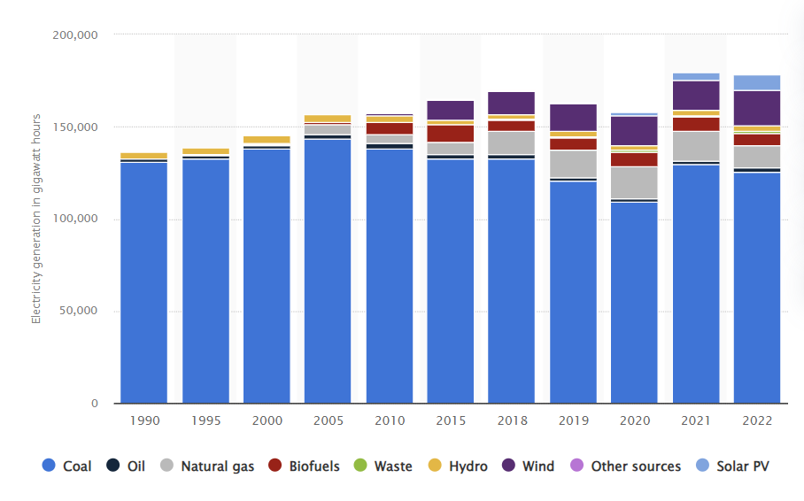
Why focus on Poland?
Source: Statista

Slide 5
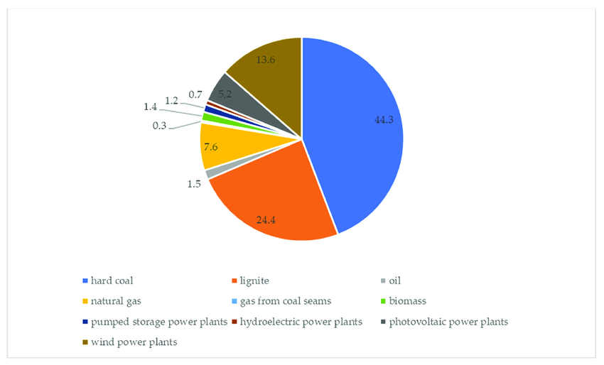
Poland’s energy mix
Source: ResearchGate
Notes:
Poland's energy sector is currently undergoing significant changes, marked by a gradual shift from coal to renewable energy sources. Despite these changes, coal remains the dominant energy source, accounting for approximately 70.7% of electricity generation in 2022. However, the share of renewable energy sources (RES) has been growing, reaching around 27% in 2023, up from 21% in 2022.

Slide 6
1. Introduction
Objective:
Investigating the relationship between ESG (Environmental, Social, and Governance) scores and Corporate Financial Performance (CFP) (Focus: in Poland's energy sector).
Significance:
Importance of ESG reporting in investment decisions and policy-making.
Global shift towards sustainable practices and reporting.
Notes:
The primary objective of this study is to investigate the relationship between ESG scores and Corporate Financial Performance, specifically within Poland's energy sector. This research is significant as it explores how ESG reporting, which encompasses environmental, social, and governance aspects, impacts financial performance. Understanding this relationship is crucial, given the global shift towards sustainable business practices and the increasing demand for transparency from investors and policymakers.

Slide 7
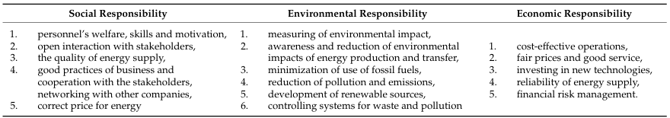
2. Background
ESG Importance:
ESG factors are becoming crucial in assessing company performance beyond traditional financial metrics.
Growing demand from investors for sustainable and responsible business practices.
Areas of responsibility in energy sector. Source: Monitor Polski 2021 r. poz. 264, Ministerstwo Energii. Polityka energetyczna Polski do 2040 r. Warszawa: Ministerstwo Energii. 2021.
Notes:
ESG factors are increasingly important in evaluating a company's performance, extending beyond traditional financial metrics. Investors are now more interested in sustainable and responsible business practices. In this context, the energy sector is particularly noteworthy. Poland's energy sector, with its historical reliance on coal, is currently undergoing significant transformation towards more sustainable and renewable energy sources. This study focuses on understanding how these changes, alongside ESG reporting, relate to financial performance.

Slide 8
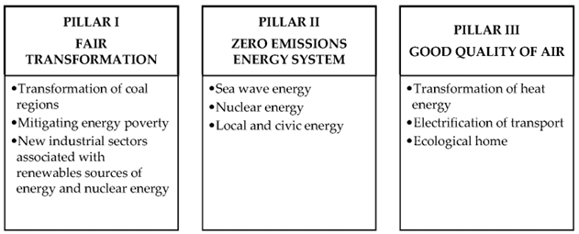
2.1 Background
Energy Sector Transformation:
The energy sector is undergoing a transformation towards more sustainable practices.
Poland's energy sector is significant due to its heavy reliance on coal and the push towards renewable energy.
Source: Stjepcevic, J.; Siksnelyte, I. Corporate Social Responsibility in Energy Sector. Transform. Bus. Econ. 2016, 16, 21–33

Slide 9
3. Data
Sample:
Eight leading companies in the Polish energy sector.
KGHM Polska Mied´ zS.A.(KGHM)
Polskie Górnictwo Naftowe i Gazownictwo S.A. (PGNiG)
Grupa Lotos S.A. (Lotos)
PGE Polska Grupa Energe tyczna S.A. (PGE)
Polski Koncern Naftowy Orlen S.A. (Orlen)
Enea S.A.(Enea)
Energa S.A.(Energa)
Tauron Polska Energia S.A. (Tauron)
Metrics Used:
ESG scores: Environmental, Social, and Governance ratings.
Financial Performance Indicators: Return on Equity (ROE), Return on Assets (ROA), Return on Sales (ROS), and DuPont model analysis.
Notes:
The data for this study was collected from eight leading companies in the Polish energy sector. The metrics used include ESG scores, which are ratings for environmental, social, and governance factors. Financial performance was measured using several indicators, such as Return on Equity (ROE), Return on Assets (ROA), Return on Sales (ROS), and the DuPont model analysis. These metrics were chosen to provide a comprehensive view of both ESG and financial performance.

Slide 10


4. Methodology
Comparative Analysis:
Comparing ESG scores with accounting-based measures of profitability.
Notes:
To investigate the relationship between ESG scores and financial performance, we conducted a comparative analysis. This involved comparing ESG scores with accounting-based measures of profitability. Additionally, they performed correlation studies to analyze the statistical relationships between ESG scores and various financial performance indicators. This methodology allowed them to rigorously examine the potential impact of ESG reporting on financial outcomes.
Here we see comparative analysis performed between ESG scores and traditional financial performance indicators. The research primarily focuses on three key financial metrics: Return on Equity (ROE), Return on Assets (ROA), and Return on Sales (ROS).

Slide 11
Contd..
Correlation Studies: Pearson Correlation Coefficient (r): Measures the linear correlation between two variables, ranging from -1 to 1.
r = 0: No correlation
0 < |r| ≤ 0.1: Faint correlation
0.1 < |r| ≤ 0.3: Weak correlation
0.3 < |r| ≤ 0.5: Average correlation
0.5 < |r| ≤ 0.7: High correlation
0.7 < |r| ≤ 0.9: Very high correlation
0.9 < |r| < 1.0: Almost total correlation
|r| = 1: Total correlation
Findings: The study calculates the correlation coefficient for ESG scores and each CFP metric to determine if higher ESG scores are associated with better financial performance.
Significance: Helps understand if sustainable practices (high ESG scores) translate to improved financial outcomes, supporting the idea that "doing good" can be financially beneficial.

Slide 12
Contd..
Determine if ESG Combined scores explain changes in CFP indicators.
Method: Ordinary Least Squares (OLS) regression.
CFP Indicators Analyzed: ROE, ROA, ROS, TAT, A/E, CR.
Model Fit Evaluation:
F-test (significance)
Coefficient of determination (R²)
Low R² Models: Considered adding a diversification variable.
Diversification Variable: Dummy variable: "0" (no diversification), "1" (≥20% income from non-energy sector)
Impact Assessment: Analyzed changes in adjusted R² (R²adj) with added variable
CFP_{Ni} = α_{N} +β_{N}· ESGcombined_{i} + ε_{i}
Notes:
In this part of our study, we aimed to determine if ESG Combined scores could explain changes in various Corporate Financial Performance (CFP) indicators using Ordinary Least Squares (OLS) regression. The CFP indicators we analyzed include Return on Equity (ROE), Return on Assets (ROA), Return on Sales (ROS), Total Asset Turnover (TAT), Asset Efficiency (A/E), and the Current Ratio (CR).
To evaluate the fit of our model, we used two key metrics: the F-test, to determine the overall significance of the regression model, and the coefficient of determination, denoted as R², to assess how well our model explains the variance in CFP indicators.
The regression model we employed can be represented by the following equation: CFPNi=\alphaN+\betaN⋅ESGcombinedi+ϵiCFPNi = \alphaN + \betaN \cdot ESGcombinedi + \epsilon_iCFPNi=\alphaN+\betaN⋅ESGcombinedi+ϵi​ where \alphaN\alphaN\alphaN is the intercept, \betaN\betaN\betaN is the coefficient for ESG Combined scores, and ϵi\epsilon_iϵi​ represents the error term
In instances where the R² values were low, indicating a weak explanatory power of the model, we explored the possibility of including a diversification variable. This variable is a dummy variable coded as '0' for companies with no diversification and '1' for companies with 20% or more of their income derived from non-energy sectors

Slide 13
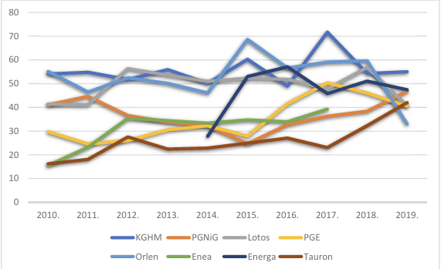
5. Results
Findings:
Key results showing the correlation between ESG scores and financial performance.
Changes in average annual values of ESG Combined indicator noted by the analyzed enterprises in the period of 2010–2019. Source -
Department of Management, WSB University, 41-300 Dąbrowa Górnicza, Poland
Notes:
Now, let’s look at the results of our analysis. The study found significant correlations between ESG scores and several financial performance indicators. For instance, as shown in this graph, there is a positive correlation between ESG scores and Return on Equity (ROE). This suggests that companies with higher ESG ratings tend to perform better financially. We will explore these correlations in more detail with additional graphs and charts.

Slide 14
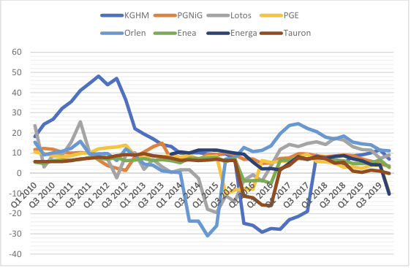
6. ROE analysis
Values of return on equity (ROE) indicator noted by analyzed enterprises in the period 2010–2019. Source: Author’s analysis
Notes:
To clearly present our findings, we have used several charts and tables. This line graph, for example, illustrates the trend between ESG scores and ROE over time. Each line represents a different company, and the height of the bar indicates the ROE value. By visualizing the data, we can see the trends and differences more clearly, making it easier to interpret the relationship between ESG scores and financial performance.

Slide 15
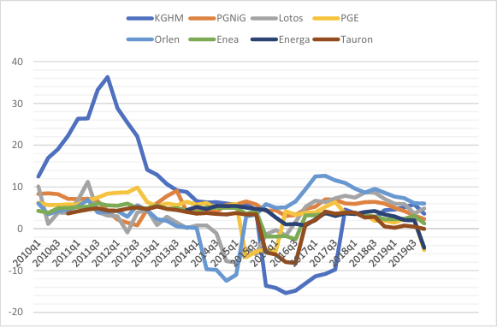
ROA analysis
Values of return on assets (ROA) indicator noted by analyzed enterprises in the period 2010–2019. Source: Author’s analysis

Slide 16
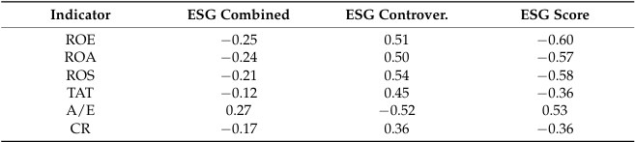
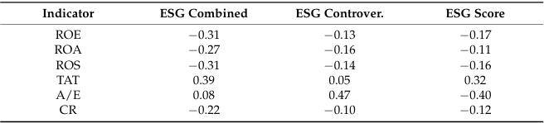
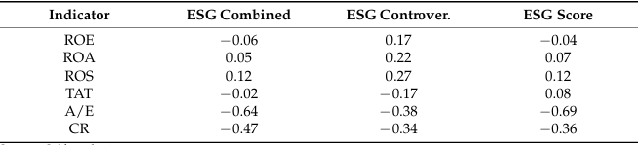
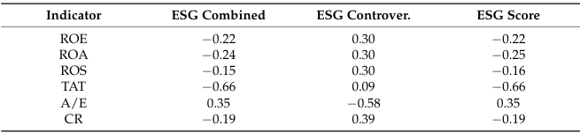
7. Interpretation in the Context of Existing Literature
Correlations between values of indicators taken into account in research in the case of the enterprise KGHM Polska Mied´ zS.A.(period of 2010 – 2019).
Correlations between values of indicators taken into account in research in the case of the enterprise Grupa Lotos S.A. (period of 2010 – 2019).
Correlations between values of indicators taken into account in research in the case of the enterprise Polskie Górnictwo Naftowe I Gazownictwo S.A.(period of 2010 – 2019).
Correlations between values of indicators taken into account in research in the case of the enterprise PGE Polska Grupa Energetyczna S.A. (period of 2010 – 2019).
Notes:
Interpreting these findings in the context of existing literature, we see both similarities and differences. Many studies have shown a positive correlation between ESG scores and financial performance, consistent with our results. However, specific aspects of the Polish energy sector, such as regulatory and economic factors, may influence these outcomes uniquely. For instance, Poland's heavy reliance on coal and the push towards renewable energy create a distinct context for ESG practices.
KGHM Polska Miedź S.A.:
Return on Equity (ROE) shows a negative correlation with ESG Controversy Score (-0.25). This suggests that as ESG controversies increase, ROE tends to decrease.
Return on Assets (ROA) exhibits a positive correlation with ESG Combined Score (0.51). Higher ESG performance aligns with better ROA.
Return on Sales (ROS) has a strong negative correlation with ESG Controversy Score (-0.60). Companies with controversies tend to have lower ROS.
Grupa Lotos S.A.:
Similar trends are observed, but with different coefficients. For instance, Grupa Lotos also shows a negative correlation between ROE and ESG Controversy Score.
Controversy Score:
The Controversy Score assesses a company’s involvement in ESG controversies. These controversies can relate to environmental issues, social practices, or governance matters.
Each ESG controversy case receives a score based on:
Severity: How significant the controversy is.
Role: The company’s alleged role in the controversy.
Status: The progress of remediation and resolution efforts
Combined Score:
The Combined Score is an overall ESG performance measure that considers both the company’s ESG Score (based on reported data) and its involvement in controversies.
When a company is involved in ESG controversies:
The Combined Score is calculated as the weighted average of the ESG Score and the Controversy Score for the fiscal period.

Slide 17
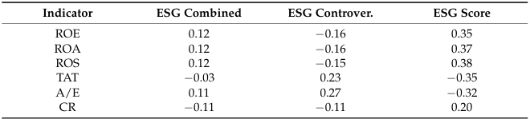
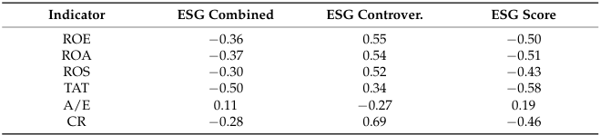
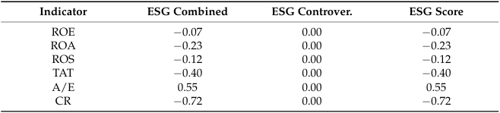
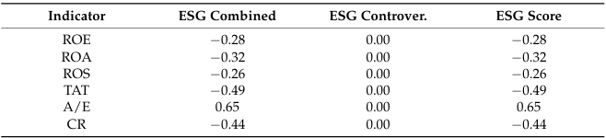
Correlations between values of indicators taken into account in research in the case of the enterprise Polski Koncern Naftowy Orlen S.A. (period of 2010 – 2019).
Correlations between values of indicators taken into account in research in the case of the enterprise Energa S.A. (period of 2014 – 2019).
Correlations between values of indicators taken into account in research in the case of the enterprise Enea S.A. (period of 2010 – 2018).
Correlations between values of indicators taken into account in research in the case of the enterprise Tauron Polska Energia S.A. (period of 2010 – 2019).
Notes:
Polski Koncern Naftowy Orlen S.A. (2010–2019):
ROE correlates negatively with ESG Controversy Score (-0.25).
ROA shows a positive correlation with ESG Combined Score (0.51).
ROS has a strong negative correlation with ESG Controversy Score (-0.60).
Energa S.A. (2014–2019):
Similar trends observed, but with different coefficients.
Enea S.A. (2010–2018):
ROE and ROA show correlations similar to the previous cases.
ROS has a moderate negative correlation with ESG Controversy Score (-0.35).
Tauron Polska Energia S.A. (2010–2019):
Again, consistent trends observed.

Slide 18
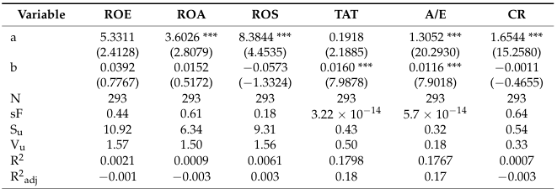
8. Statistical Significance vs Economic Significance
Inconsistent Correlation
Insignificant Relationship
Low Explanatory Power
Impact of ESG Scores
Regression Model Utility
Diversification Variable
Sector-Specific Observations
LEGENDS:
a,b – estimated parameters of the regression model sF – significance
Su – standard deviation of the residual component
Vu –coefficient of residual variation (average level of random fluctuations)
t – statistics in brackets p < 0.01.
Source – Author analysis
Notes:
It’s important to distinguish between statistical significance and economic significance. Statistically, our results are significant, as indicated by p-values and confidence intervals. However, the economic significance lies in the practical implications. For businesses and investors in the energy sector, understanding that higher ESG scores can correlate with better financial performance means that sustainable practices are not just ethically sound but also economically beneficial. Inconsistent Correlation: There is no consistent pattern or repeated correlation between ESG scores and CFP indicators.
Insignificant Relationship: For ROE, ROA, ROS, and CR indicators, there is no statistically significant relationship with ESG scores.
Low Explanatory Power: TAT and A/E indicators show a statistically significant relationship with ESG scores, but the R² values are very low (0.1798 for TAT and 0.1767 for A/E), indicating limited explanatory power.
Impact of ESG Scores: An increase in the ESG Combined score has a minor effect on TAT (0.0160 increase) and A/E (0.0116 increase).
Regression Model Utility: The linear regression model using ESG scores is not very useful for explaining CFP in the analyzed sample.
Diversification Variable: Adding a diversification variable (company activity beyond the energy sector) to the regression model increases the R²adj values significantly (to 0.4985 for TAT and 0.2433 for A/E), suggesting this variable is effective and justified.
Sector-Specific Observations: ESG activities in the energy sector are primarily adaptive to legal requirements and similar across companies. The energy market's strict regulation and state ownership limit the applicability of free-market principles, affecting the ESG-CFP relationship.

Slide 19
9. Limitations
Sample Size:
The small sample size of eight companies and its impact on the generalizability of the results.
Limitation:
The findings are specific to the Polish energy sector and may not apply to other regions or sectors.
Some other Factors:
Influencing factors such as market conditions, regulatory changes, and company-specific characteristics.
Notes:
While our study provides valuable insights, it’s crucial to acknowledge its limitations. The small sample size of eight companies may affect the generalizability of the results. Additionally, our findings are specific to the Polish energy sector and may not be applicable to other regions or industries. Other influencing factors, such as market conditions, regulatory changes, and company-specific characteristics, could also impact the relationship between ESG scores and financial performance.

Slide 20
10. Robustness Check
Methods:
Conducted additional analyses (Not mentioned) and alternative methods used to verify the robustness of the findings.
Consistency:
The results remain consistent across different tests and checks.
Notes:
To ensure the robustness of our findings, they conducted additional analyses. For example, they used alternative methods to measure financial performance and cross-verified their results. The consistency of the findings across different robustness checks strengthens the validity of our conclusions. These additional analyses confirm that the observed correlations are not merely coincidental but are indicative of a genuine relationship between ESG scores and financial performance.

Slide 21
11. Conclusion
Challenges in Modernizing Power Engineering
Complexity and frailty of the energy market
Necessity of state regulatory ownership
Role of the State
Justification for state involvement
Impact of global trends on employee-corporation identification
Delayed Transformation of Polish Energy Sector
Protective mechanisms (trade unions, political ties)
Ineffective employment structure
Consequences of Delayed Modernization
Deepening competence gap
Paralysis of modernization tools
Impact on ESG Integration
Limitations on incorporating ESG factors
Reduced materiality of socially responsible activities on economic results
Notes:
Firstly, we have examined the numerous challenges faced in modernizing power engineering. The complexity and frailty of the energy market make it evident that the state's regulatory ownership role is still necessary.
Secondly, the paper provides a critical assessment of the state's role in this process. It highlights that global trends, such as the declining identification of employees with their corporations, further justify the state's involvement.
Moving on, we have discussed the delayed transformation within the Polish energy sector. This delay can be attributed to protective mechanisms like strong trade unions and political ties, which have resulted in an ineffective employment structure.
The consequences of this delayed modernization are significant. It has led to a deepening competence gap and a paralysis of internal modernization tools.
Lastly, these conditions hamper the potential of the Polish energy sector to incorporate ESG factors into operations. This limitation impacts the relationship between socially responsible activities and the economic results of companies.
In conclusion, while state involvement in the energy sector remains crucial, it is evident that there are substantial challenges to be addressed to achieve modernization and integrate ESG factors effectively.

Slide 22
12. References
Research paper source: https://www.mdpi.com/1996-1073/15/2/477 Photo Library: Statista and ResearchGate
Statistics details (for verification): Eurostat
European Union Energy Policy :https://ec.europa.eu/energy/topics/energy-strategy/energy-policy_en

Slide 23
FH Kufstein Tirol University of Applied Sciences
The End
Thank you

